Slide 1
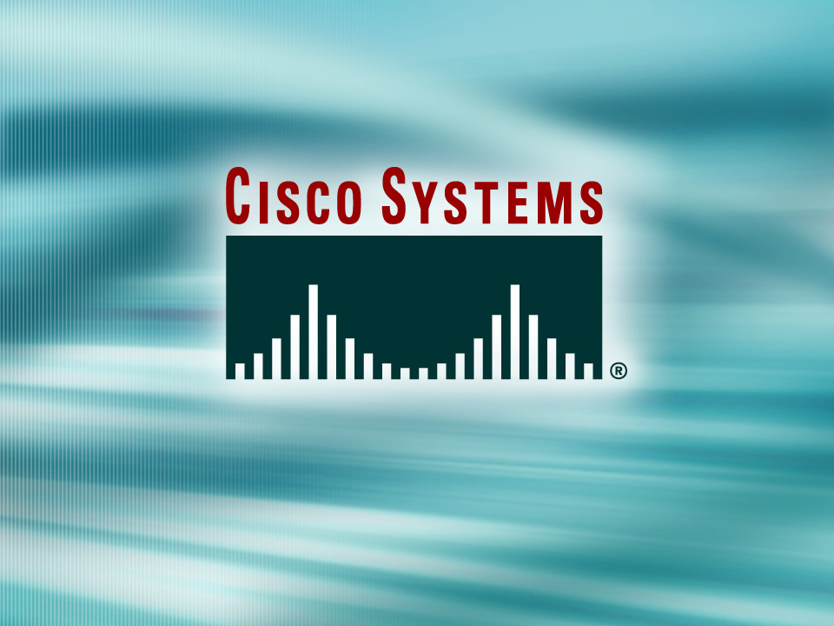
© 2002, Cisco Systems, Inc. All rights reserved.

Slide 2

Managing Cisco IOS Devices
© 2002, Cisco Systems, Inc. All rights reserved.
Notes:
Purpose: This chapter introduces the Cisco IOS™ CLI on the Catalyst® 1900 switch and router.
Timing: This chapter should take about 2 hours to present.
Note: The Catalyst 1900 switch only has a subset of the router Cisco IOS commands available.
Contents:
Introduction to Cisco IOS. Explain to the student what is IOS?
Cisco Device startup procedures in general.
IOS configuration source.
General introduction to the IOS CLI.
Cat 1900 switch startup procedures.
Intro to Cat 1900 CLI. This part covers the basic configuration on the switch, like setting the IP address and hostname. More details about the various Cat 1900 switch configuration commands are explained in Chapter 6 and 7.
Router startup procedures. More details on the router startup process is discussed in chapter 5.
Router IOS CLI.

Slide 3
Objectives
Upon completing this lesson, you will be
able to:
  Manage IOS image files to maintain accessible IOS images according to best practices, given operational access layer switches, routers, and a TFTP server
  Manage device configuration files to reduce device downtime according to best practices, given operational access layer switches, routers, and a TFTP server
  Execute an add, move, or change on a router, given a new network requirement
  Handle the troubleshooting process to minimize any potentially adverse impact on Cisco devices
Notes:
Slide 1 of 2
Purpose: This slide states the chapter objectives.
Emphasize: Read or state each objective so that each student has a clear understanding of the chapter objectives.
Note: Catalyst switches have different CLIs. The Catalyst 2900xl and the Catalyst 1900 has a Cisco IOS CLI. The Cisco IOS CLI commands available on the 2900xl is different from the 1900. The Catalyst 5000 family has no Cisco IOS CLI, and use the set commands instead. This class only covers the configuration on the Catalyst 1900 switch.

Slide 4
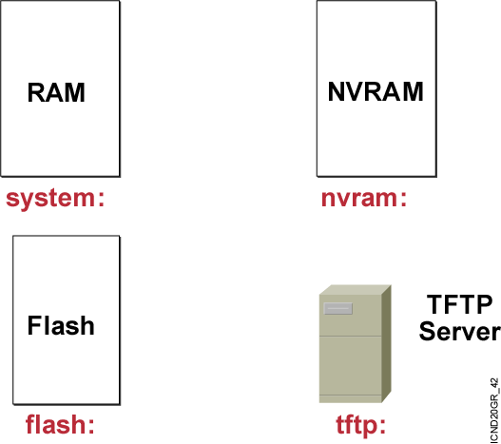
Cisco IOS File System and Devices
Notes:
Emphasize: In Cisco IOS Release 12.0, there are new copy commands. These new commands treat the RAM, Flash, NVRAM, TFTP, FTP, and so on as a file system. Since this class was developed when the most common Cisco IOS in the field is pre-12.0, these 12.0 commands are not covered in detail in this class.

Slide 5
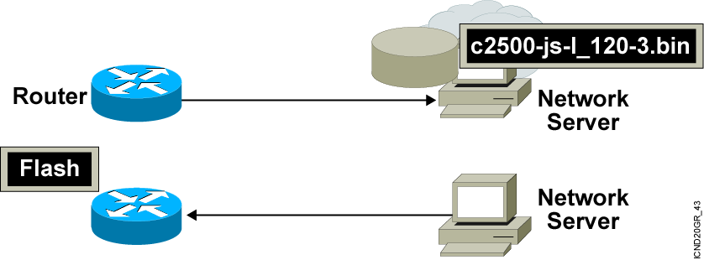
Managing Cisco IOS Images
Notes:
Emphasize: This section introduces topics on managing your configuration file and Cisco IOS image.

Slide 6
Verifying Memory and Deciphering Image Filenames
wg_ro_a#show flash
System flash directory:
File Length Name/status
1 10084696 c2500-js-l_120-3.bin
[10084760 bytes used, 6692456 available, 16777216 total]
16384K bytes of processor board System flash (Read ONLY)
  Verify that flash memory has room for the
  Cisco IOS image.
Notes:
Emphasize: The show flash command is an important tool to use to gather information about your router memory and image file. Caution students that they must know that they are loading the correct and appropriate image. The name for the Cisco IOS image file contains multiple parts, each with a specific meaning:
The first part of the image name contains the platform on which the image runs. In this example, the platform is C2500.
The second part of the name identifies the special capabilities of the image file. A letter or series of letters identifies the feature sets supported in that image. In this example, the “j” indicates this is an enterprise image, and the “s” indicates it contains extended capabilities.
The third part of the name specifies where the image runs and if the file is compressed. In this example, “l” indicates the file is relocatable and not compressed. Relocatable means the Cisco IOS can be run from Flash or from RAM. You should be careful in reading the Cisco IOS image filename. Some fonts display the lowercase letter “l” and the number 1 as the same character. How you enter the characters will impact the ability of the router to load the files correctly.
The fourth part of the name indicates the version number. In this example, the version number is 12.0 (3).
The final part of the name is the file extension. The .bin extension indicates this file is a binary executable file.
The Cisco IOS software naming conventions, name part field meaning, image content, and other details are subject to change. Refer to Cisco Connection Online (CCO) for updated details.

Slide 7
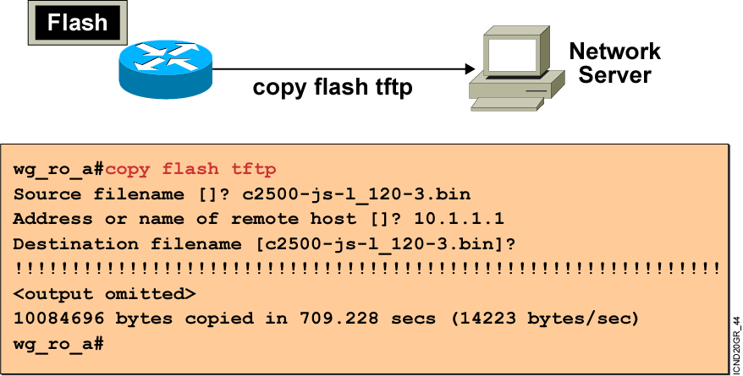
Creating a Software Image Backup
Back up current files prior to updating flash memory.
Notes:
Purpose: This slide discusses how to create a backup version of a Cisco IOS software image to a TFTP server.
Emphasize: Routers by default come with Flash memory that has a preloaded copy of the Cisco IOS software. Although Flash is extremely reliable—good for 65 years and 100,000 rewrites—it is a good idea to make a backup copy of the Cisco IOS software if you have a TFTP server available. If you have to replace Flash memory for some reason, you will have a backup copy at the revision level currently running on your network.
The copy command screen output varies depending on the Cisco IOS software level.
Determine the platform type of your TFTP server prior to beginning the backup procedure. The TFTP server may be running Windows, UNIX, Mac, or other OS. Filename and directory access procedures may vary depending on the TFTP server platform and platform version.

Slide 8
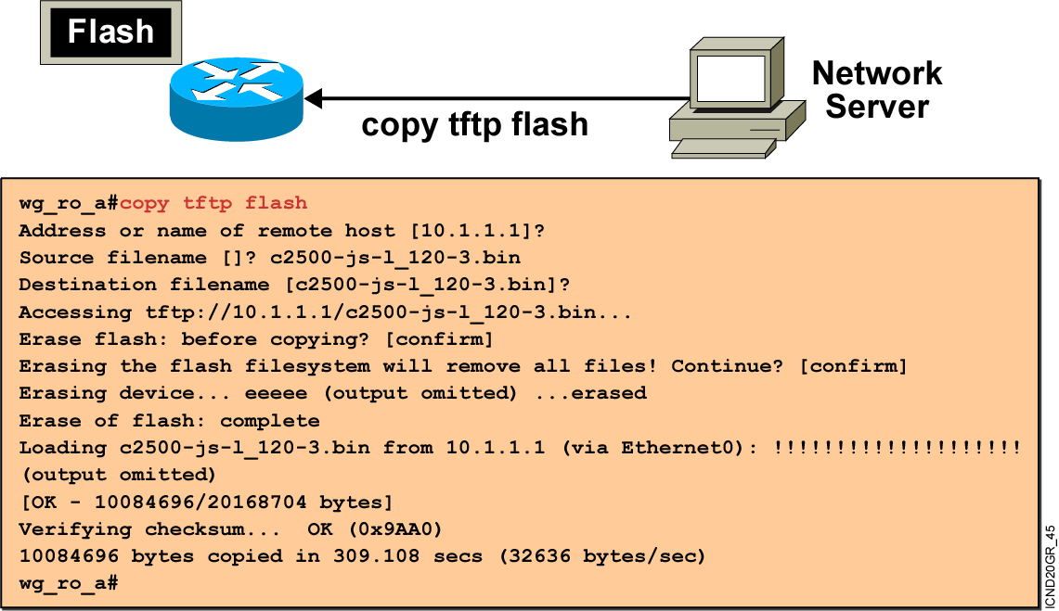
Upgrading the Image from the Network
Notes:
Purpose: This slide describes how to load a backup version of a Cisco IOS software image from a TFTP server to the router.
Emphasize: If you need more Flash space to load a copy of the Cisco IOS software, you must first erase the Flash memory. You cannot erase a single image—you must erase all copies of Cisco IOS software from Flash. However, if Flash memory on the router is partitioned, you can erase one or more of the parts.
After the TFTP transfer is completed, use the show flash command to view the file size to compare its size with that of the original on the server.
If the Cisco IOS is running from Flash, then the Flash is in the read-only state. To change the Flash to a writeable state, you can use the boot system TFTP command to boot a Cisco IOS from a TFTP server and the Cisco IOS will be run from RAM, or you can go to the Rxboot mode to perform the copy.

Slide 9
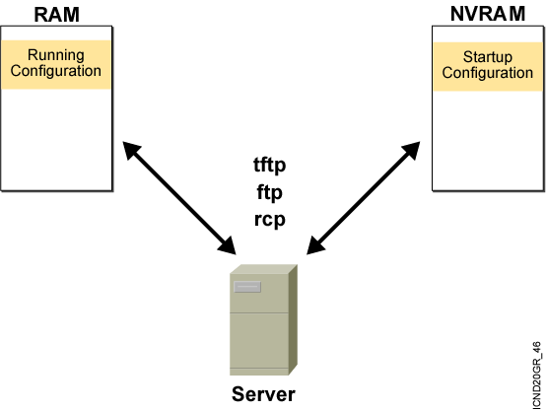
Device Configuration Files

Slide 10
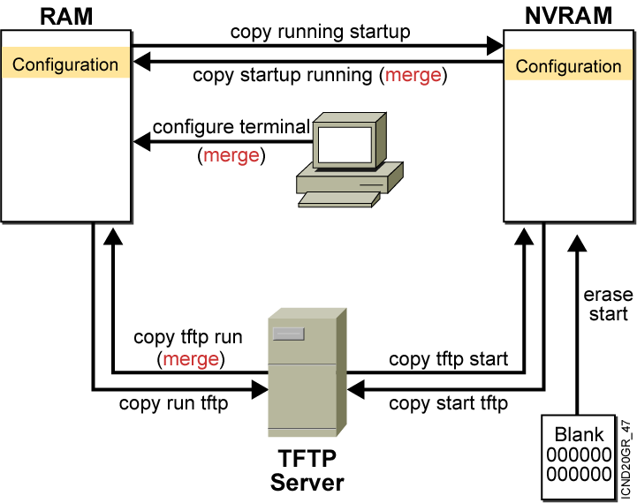
Cisco IOS copy Command
  NVRAM
  Terminal
  TFTP server
  Erase start
Notes:
Layer 4 of 4

Slide 11
Cisco IOS copy
Command Example
running-config
TFTP Server saved.cfg
interface s0
ip address 10.1.1.1 255.255.255.0
interface e0
ip address 10.2.2.2 255.255.255.0
interface e1
no ip address
interface e0
ip address 172.16.1.1 255.255.255.0
interface e1
ip address 192.168.1.1 255.255.255.0
copy tftp run (merged)
interface s0
ip address 10.1.1.1 255.255.255.0
interface e0
ip address 172.16.1.1 255.255.255.0
interface e1
ip address 192.168.1.1 255.255.255.0
Resulting
running-config
Notes:
Note: Cisco IOS Release 12.0 supports a new syntax for the copy command.

Slide 12
copy run tftp and copy tftp run Commands
wg_ro_a#copy running-config tftp
Address or name of remote host []? 10.1.1.1
Destination filename [running-config]? wgroa.cfg
.!!
1684 bytes copied in 13.300 secs (129 bytes/sec)
wg_ro_a#copy tftp running-config
Address or name of remote host []? 10.1.1.1
Source filename []? wgroa.cfg
Destination filename [running-config]?
Accessing tftp://10.1.1.1/wgroa.cfg...
Loading wgroa.cfg from 10.1.1.1 (via Ethernet0): !
[OK - 1684/3072 bytes]
1684 bytes copied in 17.692 secs (99 bytes/sec)
Notes:
Note: Cisco IOS Release 12.0 supports a new syntax for the copy command.

Slide 13
Adding New Devices to the Network
  Determine the IP address to be used for management purposes.
  Configure administrative access for the console, auxiliary, and vty interfaces.
  Configure passwords for the privileged EXEC mode for the device.
  Configure the network management access to the device.
  Determine the IP address to assign to each interface.
  Configure the new device with the appropriate configuration.

Slide 14
Moving Devices on the Network
  Determine what to do with the obsolete equipment.
    Which devices connect to the equipment being moved?
    Will the move and reconfiguration affect the security policy?
    Does the device play a role that no other devices play?
  Review the facilities for the new location.
  After the move, test network connectivity.

Slide 15
Changing the Hardware
Hardware changes
  Power down the equipment or use OIR.
  Make sure the appropriate modules are available.
  Read the hardware installation manual.
  Verify your organization’s policies.
Cisco IOS software changes
  Does the new version support the current and future features you need?
  Does your platform have sufficient RAM and flash memory to support the feature set?

Slide 16
show and debug Commands
Processing characteristic
Processing load
Primary use
show
Static
Low overhead
Gather facts
debug
Dynamic
High overhead
Observe processes

Slide 17
Considerations When Using debug Commands
  May generate output in a variety of formats that may not identify the problem
  Require high overhead, possibly disrupting network device operation
  Useful for obtaining information about network traffic and router status

Slide 18
Commands Related to debug
  Router(config)#service timestamps debug datetime msec
  Router#show processes
  CPU utilization for five seconds: 0%/0%; one minute: 0%; five minutes: 0%
  PID Q Ty PC Runtime(ms) Invoked uSecs Stacks TTY Process
  1 C sp 602F3AF0 0 1627 0 2600/3000 0 Load Meter
  2 L we 60C5BE00 4 136 29 5572/6000 0 CEF Scanner
  3 L st 602D90F8 1676 837 2002 5740/6000 0 Check heaps
  4 C we 602D08F8 0 1 0 5568/6000 0 Chunk Manager
  5 C we 602DF0E8 0 1 0 5592/6000 0 Pool Manager
  6 M st 60251E38 0 2 0 5560/6000 0 Timers
  Router#no debug all

Slide 19
Summary
  The Cisco IOS File System feature provides a single interface to all the file systems that a router uses.
  As your network grows, you may want to store
  your Cisco IOS software and configuration files on a central server, which would allow you to control the number and revision level of software images and configuration files you must maintain.
  Device configuration files contain a set of
  user-configured commands that customize the functionality of your Cisco device.
Notes:
Purpose: This slide discuss the initial configurations on the routers and switches.
Note: There is no setup mode on the Catalyst 1900 switch.

Slide 20
Summary (Cont.)
  You use the Cisco IOS software copy commands to move configurations from one component or device to another, such as RAM, NVRAM, or a file server.
  Network equipment is often moved from one location to another, removed from the network, or the configuration may change. The process is referred to as adds, moves, and changes.
  The show and debug commands are built-in tools for troubleshooting. The show command is used to display static information, while the debug command is used to display dynamic data.

Slide 21
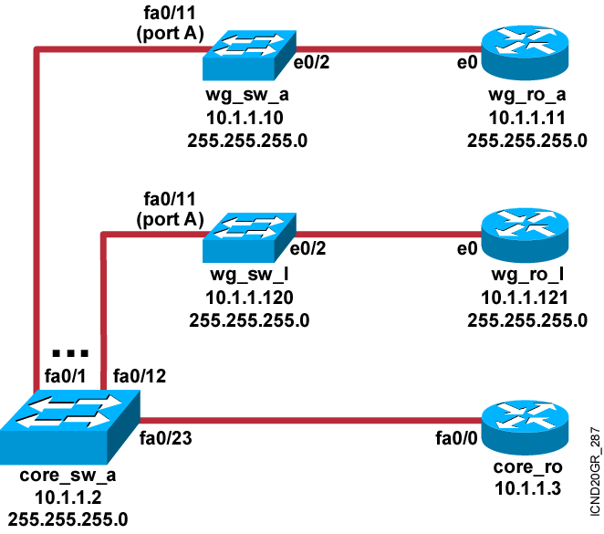
Visual Objective 2-1: Gathering Information and Using System Files
Pod Switch Router Ethernet
A 10.1.1.10 10.1.1.11
B 10.1.1.20 10.1.1.21
C 10.1.1.30 10.1.1.31
D 10.1.1.40 10.1.1.41
E 10.1.1.50 10.1.1.51
F 10.1.1.60 10.1.1.61
G 10.1.1.70 10.1.1.71
H 10.1.1.80 10.1.1.81
I 10.1.1.90 10.1.1.91
J 10.1.1.100 10.1.1.101
K 10.1.1.110 10.1.1.111
L 10.1.1.120 10.1.1.121
Notes:
Lab ?
Missing link core_ro ------core_sw_a. Fixed, kcm.

Slide 22


